Slide 1

Lecture 5: IT in Commerce
Hoger Mahmud

Slide 2



Lecture outline
E- commerce
E-commerce process
Difference between e-commerce and e-business
E-commerce infrastructure
Software and hardware used in e-commerce
Advantages of using IT in e-commerce
2

Slide 3

What is ecommerce
E-commerce involves
Digitally enabled commercial transactions between organizations and individuals.
Digitally enabled transactions include all transactions mediated by digital technology
3

Slide 4
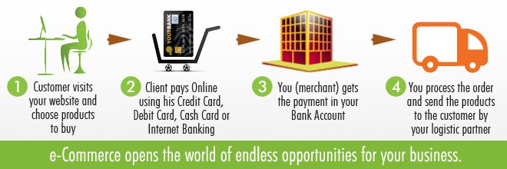
Ecommerce process
4

Slide 5
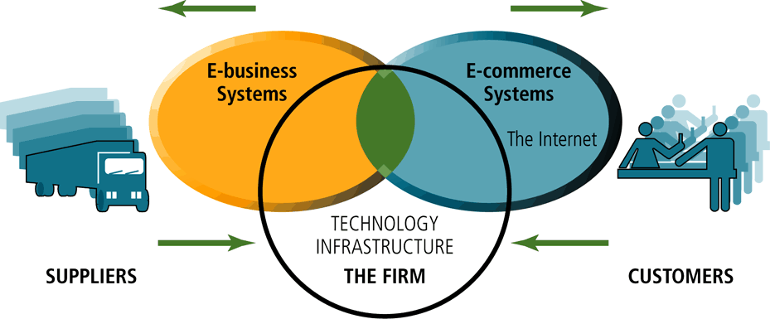
The difference between ecommerce and ebusiness
5

Slide 6
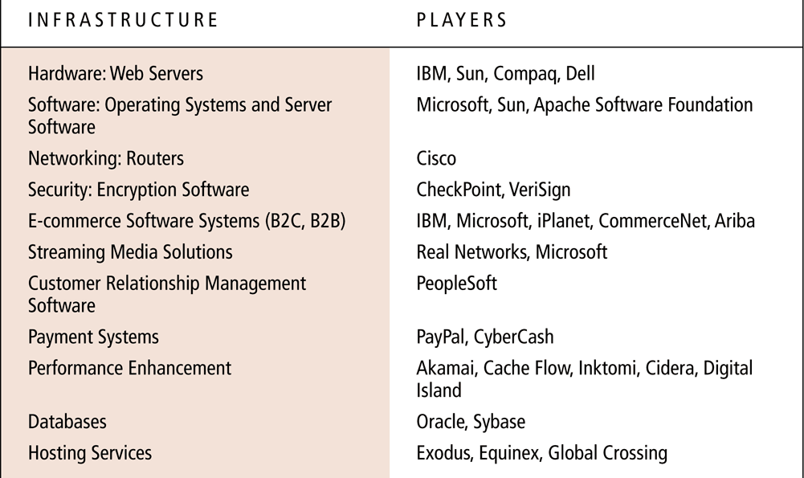
E-commerce infrastructure
6

Slide 7
Technical structure of ecommerce system
Server side
Client side
Service system
Backend system
7

Slide 8
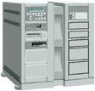

Architecture of ecommerce system
Service system
Backend system
Web Server
Application Server
Internet
Database
Firewall
Intranet
(Secure)
Client side
Server side
8

Slide 9
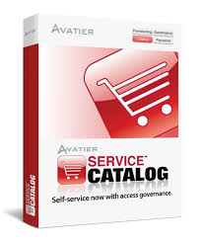
Ecommerce software
Catalog management
Product configuration
Shopping cart facilities
E-commerce transaction processing
Web sites
E-payment software
9

Slide 10
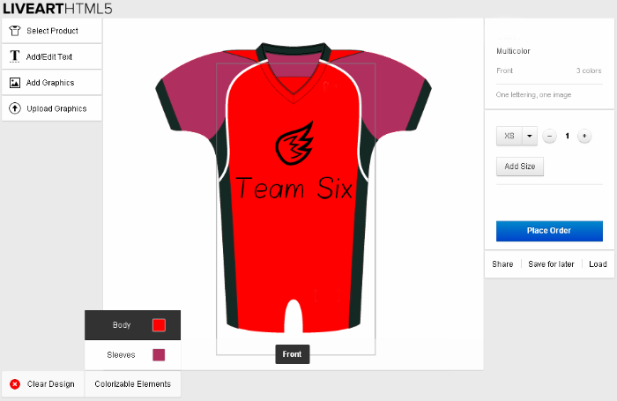
Example of product configuration software
10

Slide 11
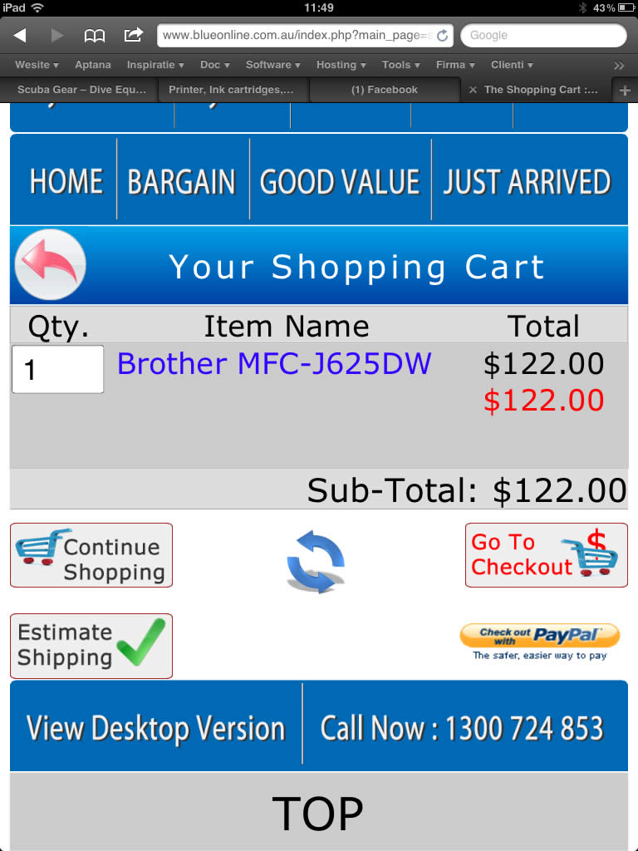
Example of Shopping cart software
A shopping cart:
Keeps track of items selected
Allows you to view the items in a cart
Allows you to change quantities of items
11

Slide 12
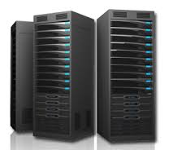

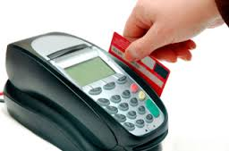
Hardware used in ecommerce
E-commerce involves
Servers
Database
Payment systems
Network devices
12

Slide 13
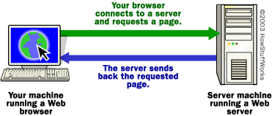
How servers work
13

Slide 14
IT Factors affecting ecommerce
Hardware and operating system choice
Speed of connection to the Internet
User capacity
Throughput: The number of HTTP requests that can be processed in a given time period.
Response time: The amount of time a server requires to process one request.
The mix and type of Web pages
Static pages
Dynamic pages: Shaped in response to users.
14

Slide 15
Benefits using IT in commerce
Immediacy - no going to the shops or waiting in queues
price - goods bought online tend to be cheaper
choice - the range of goods available is vast
24-hour availability - the shop never closes
speed - you'll locate what you want much quicker
global markets - neither you nor the vendor are restricted to your/their locality
interactivity - get immediate feedback on prices, features etc
less paperwork - always a good thing!
15

Slide 16

Thank you
?

